Slide 1

SyriaTel
By Charlie Jin SyriaTel Employee
Presenting to: SyriaTel Board

Slide 2
Business Problem
A large amount of users leaving the telephone/internet subscription service that SyriaTel provides.
How to prevent more users from leaving

Slide 3
First Steps
Identify who and how many people have left
Identify any false data entries

Slide 4
Interpreting my Metrics
METRIC FOR DETERMINING WHO HAS LEFT
Method for preventing further users from leaving
Recall score of my classification model
Try to obtain the best recall score as possible.
After finding recall score, we will know the False Negative total
False Negatives = people who are predicted to still be in service, but have actually left.
Look to precision score
Precision score will yield the False Positive Value
False Positives = users who are predicted to have left, but actually hasn’t.
We need to target these users, because model predicts that they’ll leave. We need to prevent these specific (False Positive) users from leaving.

Slide 5
Further Methods
How to identify False Negatives
Results
Model predicts 38 False Negatives.
Model predicts 58 False Positives.
Our goal is to target those 58 False Positive users, because model predicts they stand a very high chance of leaving.
How to find those users?
By:
Area Code
State
Model points out people in Texas, New Jersey, Maryland, Michigan, and New York have reported to have left the most.
Model points out area code 415 in New York, Connecticut, Nevada, Arkansas, and Texas have reported to have left the most.

Slide 6
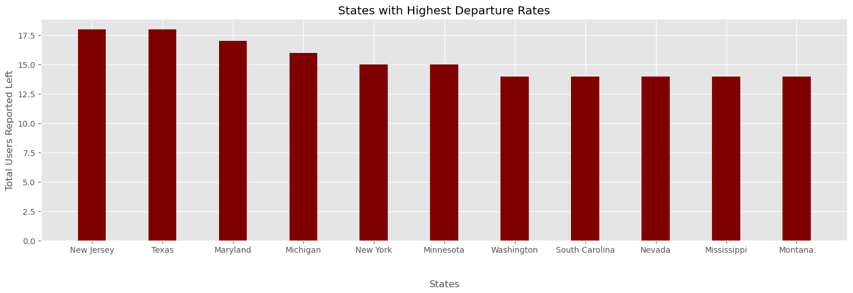

Slide 7
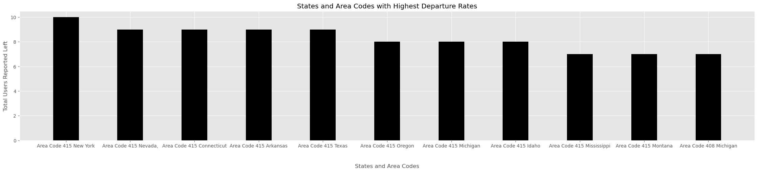

Slide 8
Final Goal
Final plan
Recommendations
Locate the users who are predicted high chance of leaving using previous slide’s metric.
Call users from previously mentioned high departure states.
Call users from Texas, New York, Connecticut, Nevada, and Arkansas with area code 415.
Offer deals, bundles, discounts to those users

